Slide 1

Car Listing
Aashutosh Krishnan, Kevin Puga, Hoang Tran, John Thomas, Saurabh Mittal, Edith Solorzano, Blanca Berrios

Slide 2
About our PROJECT
A system to manage a database of used car listings.
Provides a front-end interface for users to:
Browse and search car options.
Filter listings based on attributes such as:
Make, Model, Year, Color, Features, Location, and Price.
Accessible for:
Car dealerships
Independent sellers
Potential buyers

Slide 3


Motivation
Growing demand for easy-to-use platforms to browse and compare used cars.
Inspired by existing systems like CarMax and AutoTrader.
Aim to provide a scalable and versatile solution that isn’t limited to one dealership.

Slide 4
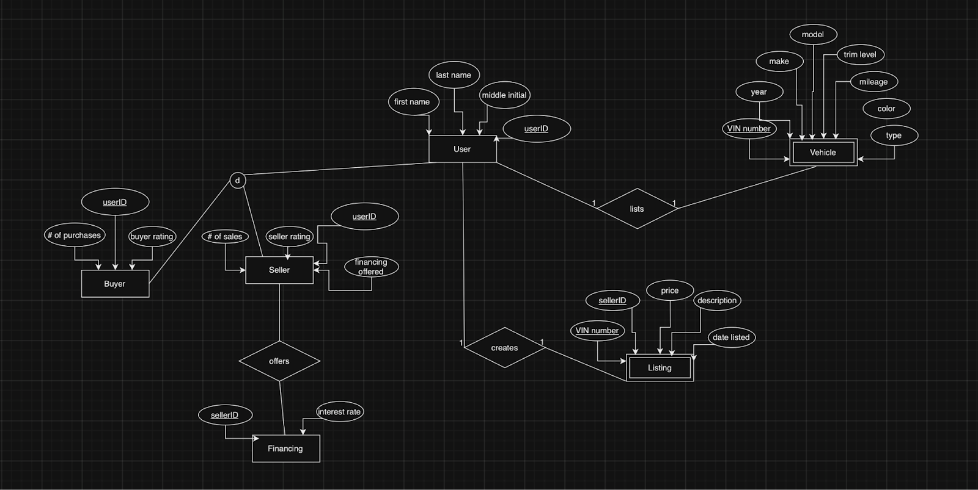
EER

Slide 5
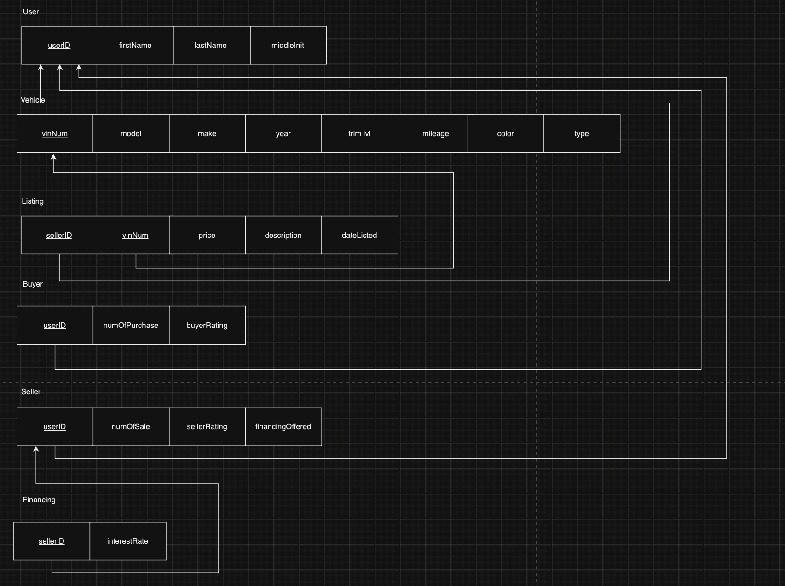
Relational Data Model

Slide 6
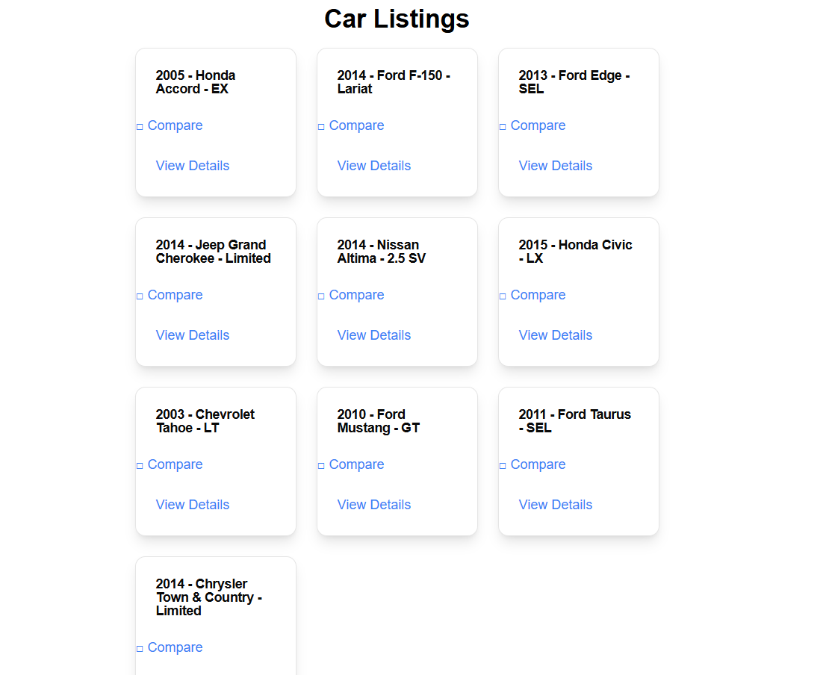
Implementation:
car-listing-delta.vercel.app

Slide 7
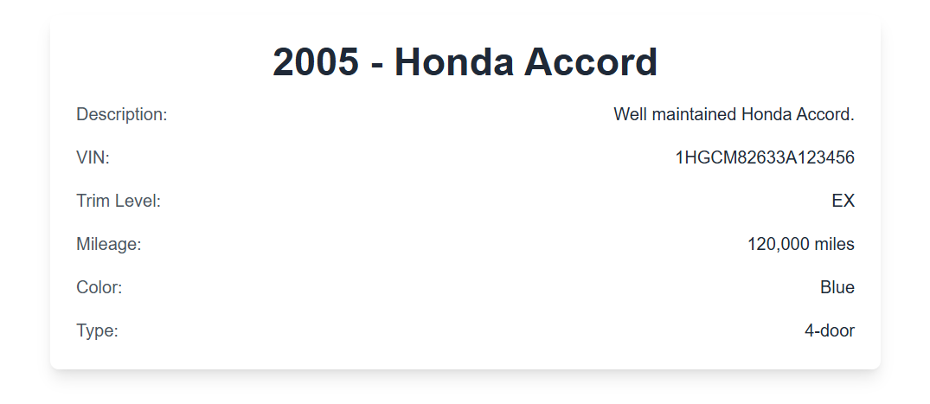
Query
SELECT
l.description,
v.vinnum, v.trim_lvl, v.mileage, v.color, v.type
FROM vehicle v
LEFT JOIN listing l
ON v.vinnum = l.vinnum
WHERE v.vinnum = '1HGCM82633A123456';

Slide 8
INSERT
INSERT INTO vehicle (vinnum, year, make, model, trim_lvl, mileage, color, type)
VALUES ('1HGCM82633A654321', 2022, 'Toyota', 'Camry', 'SE', 5000, 'Red', 'Sedan');

Slide 9
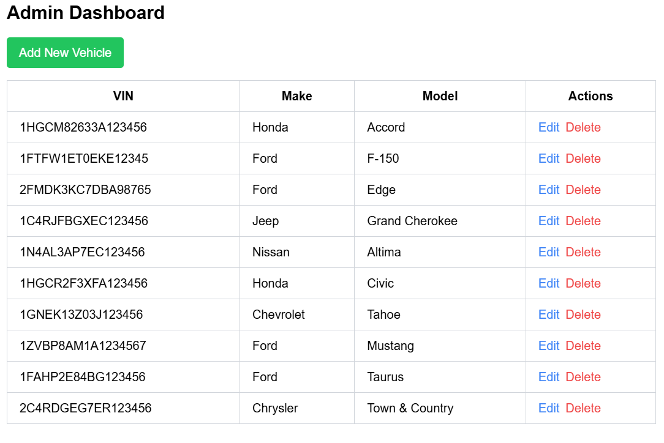
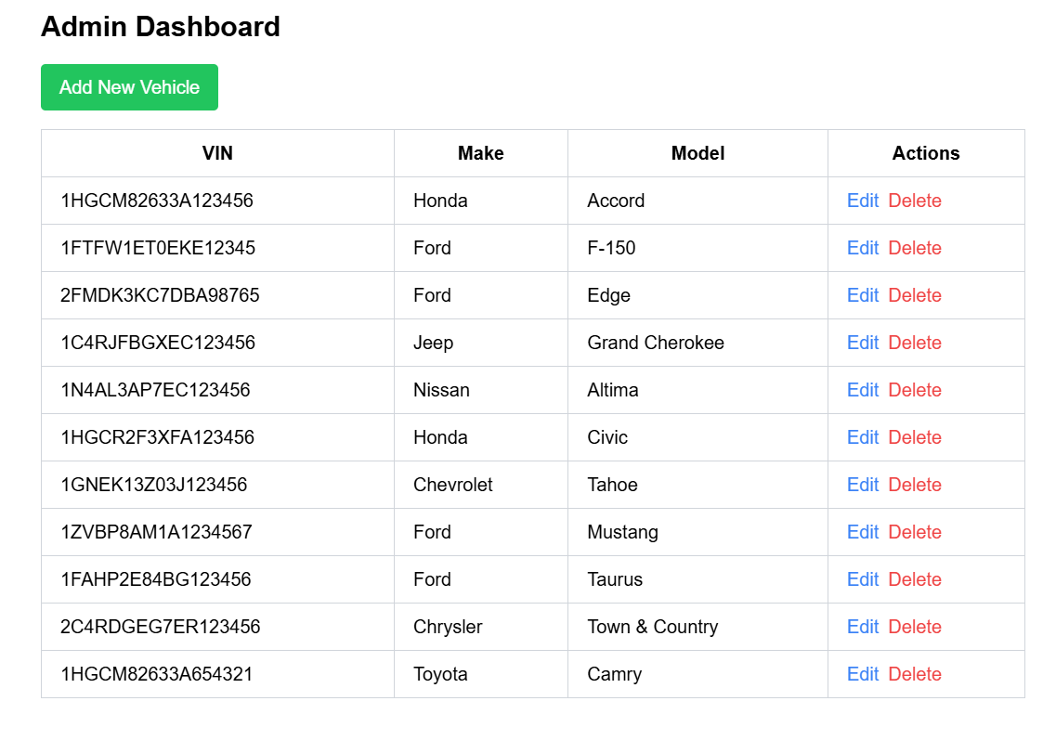
Insert
Before | After

Slide 10
DELETE
DELETE FROM vehicle
WHERE vinnum = '1HGCM82633A123456';

Slide 11
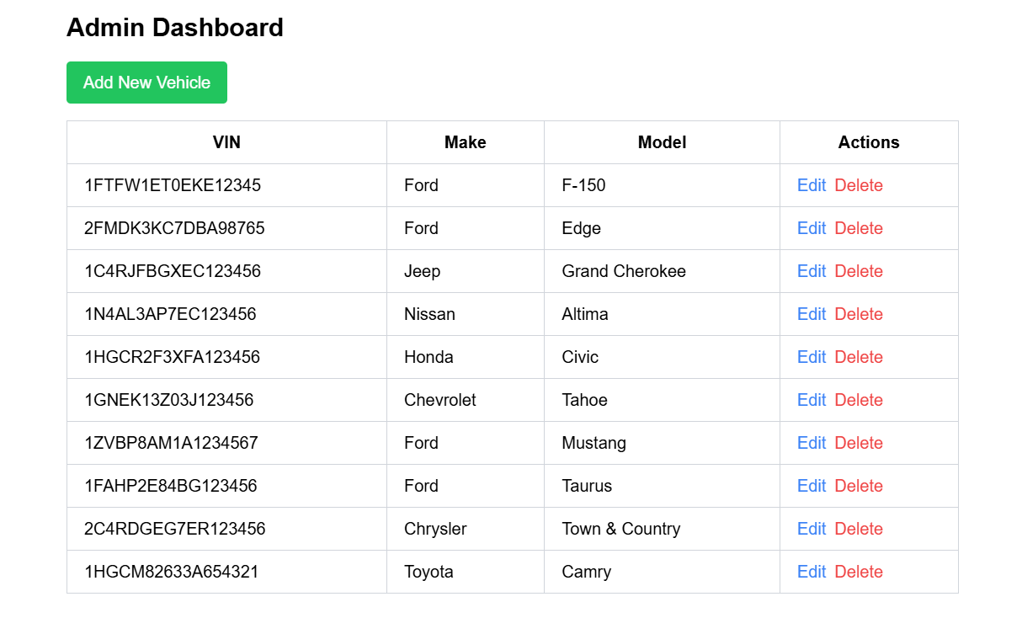
Delete

Slide 12
UPDATE
UPDATE vehicle
SET color = 'Yellow', mileage = 200000
WHERE vinnum = '1FTFW1ET0EKE12345';
UPDATE listing
SET description = 'Great condition Ford F-150, has been repainted yellow.'
WHERE vinnum = '1FTFW1ET0EKE12345';

Slide 13
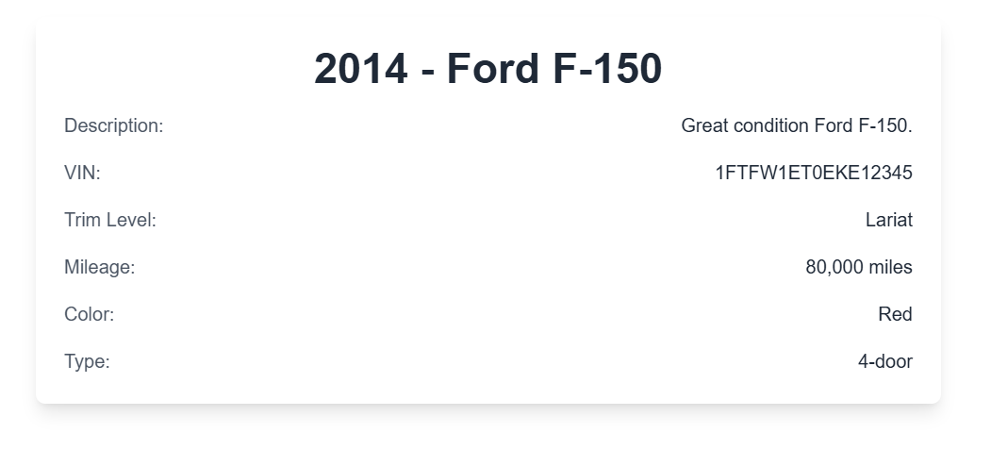
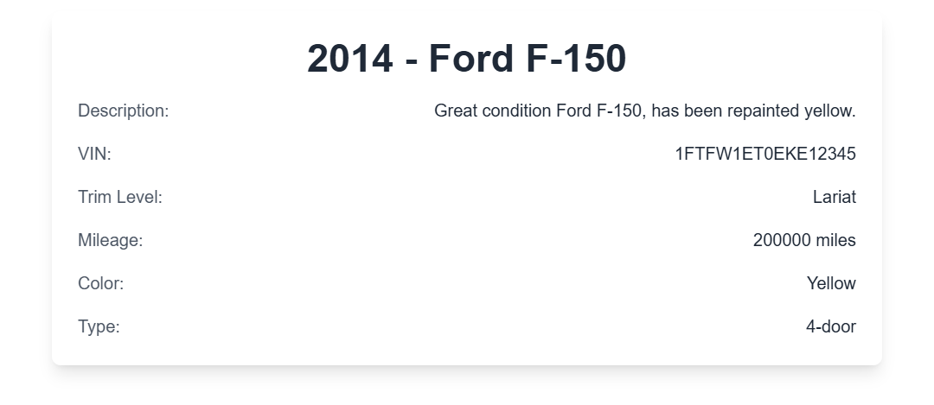
Update

Slide 14
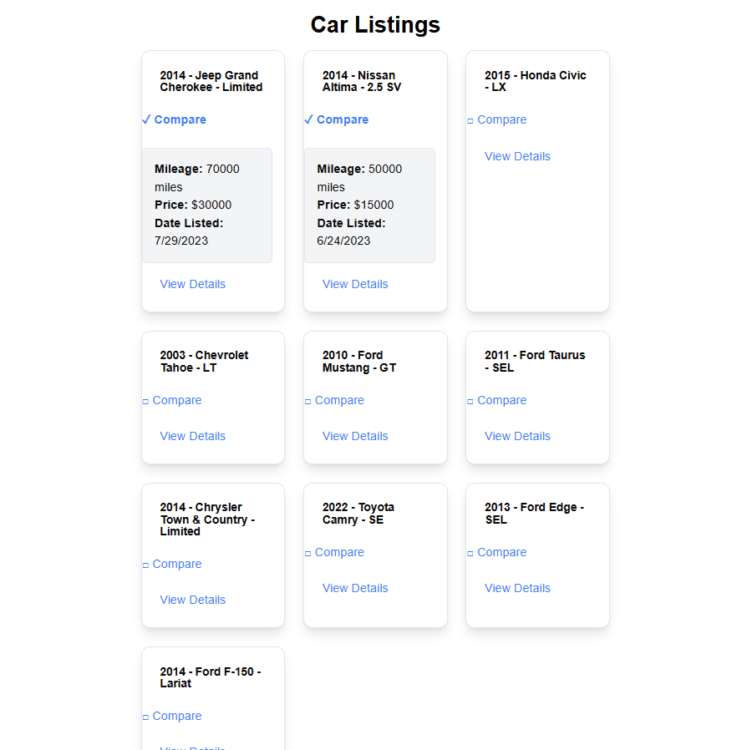
View
CREATE VIEW Compare AS
SELECT v.make, v.model, v.mileage, l.price, l.datelisted
FROM vehicle v
JOIN listing l
ON v.vinnum = l.vinnum
WHERE v.make IN ('Nissan', 'Jeep');

Slide 15
Conclusion and Future Work
Not much change as everyone did their roles
Admin/Superuser implemented – CRUD Privileges
Implementing advanced search functionality

